Slide 1
Washington State GEAR UP Year 5 Kickoff Workshop
August 17, 2021, 9 AM-2 PM
Virtual Event
Notes:
Marcie

Slide 2
Welcome & Introductions
Marcie Sample, GEAR UP Director
Beth Kelly, Assistant Director for College Access and Support
Kelly Keeney, Program Specialist
Buffy Hatcher, Fiscal Program Manager
Annie Pocklington, Program Associate for Student Support Services
Christina Winstead,
Assistant Director for Outreach
Notes:
Marcie –
Note Weiya’s retirement

Slide 3
Objectives
/
Identify strategies and interventions to best support student engagement and college knowledge.
Learn ways to support students transitioning from high school to college, including the Senior Exit Survey, Texting Campaign Pilot, and the 7th Year Student Advisory Board.
Learn about campus visit options (both virtual and in-person).
Understand financial aid resources and workshop opportunities available for school staff, families, and students.
Define and document roles, resources, and activities to support grant benchmarks and goals as a school team. Finalize RACI for the academic year.
Hear about grant logistics and legislative updates to College Bound Scholarship and the WASFA.
Notes:
Marcie
Note loss of opportunities, COVID impact on learning loss, college and career field trips, postsecondary enrollment, financial aid applications.
Shift from Ready Set Grad to WSAC for educators/staff – but not for students, GEAR UP student/family page is the best resource.
Big changes in College Bound Scholarship.
For priority schools, focus on getting back on track and regaining some of the traction we lost during remote learning.
For cohort schools, focus on making up for lost time and doubling our efforts on postsecondary planning and financial aid.

Slide 4
Housekeeping
Zoom Housekeeping and Recording.
Breaks.
Clock hour procedures.
Notes:
Beth – stay muted, more guidance later in the session.
Beth – cover Clock hours
Breaks – you will have breaks built into your team time
Add that we will record part of day

Slide 5
Rename Yourself
Hover your mouse over your name in the “Participants” list on the right side of the Zoom window. Click on “Rename”.
Priority School Staff: P – School Name -Your Name
P-Willapa–Ann
Cohort School Staff: C – School Name- Your Name
C-Eastmont-Scott
Notes:
Beth

Slide 6
Clock Hour Procedure
Title: Washington State GEAR UP Year 5 Kickoff Workshop
Event #: 133937 (use this when referring to your event)
# of Hours: 4.5
Registration link: https://www.pdenroller.org/esd113/catalog/133937
Notes:
Beth
If you want clock hours then you needed to pre-register for the clock hours, through ESD113, prior to the event.
Because this is an online event, your attendance will be documented by Zoom logs and an affidavit from WSAC.

Slide 7
Staff Changes & Updates
Aberdeen – Welcome Aaron, new principal.
Bellingham – Welcome Chimere, new admin support. Looking forward to a new Graduation Specialist.
Davenport – Congrats to Heather on your new job. Welcome to Elesha!
East Valley – Congrats Dave on your new job. Looking forward to meeting your replacement.
Eastmont – Congrats Nicole on your new job. Looking forward to meeting your replacement.
Notes:
Marcie

Slide 8
Staff Changes & Updates
Federal Way - Congrats to Stephanie and her new baby girl, Olivia! We will also have new admin leadership.
Kettle Falls – Welcome to new principal Keith Wells. Congrats Brittney on your new job. Looking forward to meeting new staff.
Naselle – Goodbye Rachael, hello Andrea.
North Beach – Goodbye to Iesha and welcome to Kari.
Shadle Park – Welcome to Chris Dunn, new admin lead.
Vancouver – Goodbye and good luck to Natalie.
Notes:
Marcie

Slide 9
Student Support Services
Annie Pocklington, Program Associate

Slide 10
Training Opportunities
If you said yes to a FOCUS experience at your school this fall, keep your eyes on your email!
GU Staff are required to be present the entire time FOCUS is inside your building.
Lyndsey Howe will follow up with date options & logistics.
Notes:
Annie

Slide 11
7th Year Student Advisory Committee
We need your help recruiting current juniors and seniors for our 7th Year Student Advisory Committee.
Required monthly meetings (2 hours max).
Stipend for monthly participation.
Students do NOT need to be ‘college going.’
Looking for diverse representation from our GEAR UP population.
Opportunity for community building and mentoring.
Great resume builder.
Watch for an email with more information in October!
Notes:
Annie

Slide 12
Text Campaign
It’s an important year for the text campaign!
Priority Schools | Cohort Schools
Junior and Senior Sign-Ups | Junior Sign-Ups
Marketing materials provided. | Marketing materials provided.
Annie will visit this fall for sign-ups. | Annie will host a webinar and distribute.
Counting on you to promote and make sure students are signed up! | Counting on you to promote and make sure students are signed up!
Notes:
Annie

Slide 13
Campus Visits
Most Washington State institutions are open for in-person campus visits and are excited to have you!
Nearly all these schools are also providing virtual visit options.
A small variety of virtual campus visits will be conducted by Annie this fall, but the focus will be on institutions without their own virtual visits.
A campus visit contact list has been created and will be shared out so you can begin planning for campus visits.
Notes:
Annie – see email last week for details

Slide 14
Virtual Visits and Fairs
Washington State Institutions Offering Virtual Tours
National and International Institutions Offering Virtual Tours
2021 NACAC Virtual College Fair
Notes:
Annie – reminder to watch the bulletin for availability

Slide 15
Senior Exit Surveys
172 GEAR UP students responded.
96.5% reported they were graduating.
53% of respondents indicated they have a plan for postsecondary training or education.
56% of respondents completed a FAFSA or WASFA.
Notes:
Annie – a reminder that we had about 315 GU 12th graders last year, so remember that this may or may not be representative of all GU students in the Class of 2021.

Slide 16
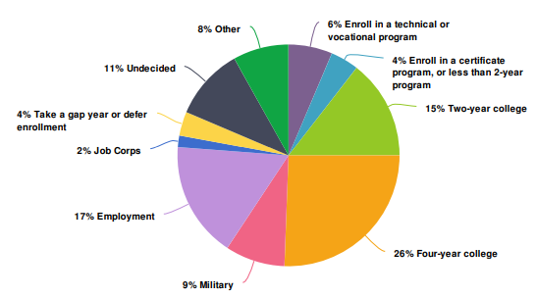
Post-High School Plans
What are your plans after high school?
Several of the “Other” responses indicated they were working, going to school, or going into the military.
Notes:
Annie

Slide 17
If not attending college, why?
Opportunities:
How do we convince the “I can’t afford it” and “I need to have an income” students that there is money for them to go to school, and often that helps with living expenses?
Washington State has the BEST STATE FINANCIAL AID IN THE COUNTRY! We are #1 in the nation! Do we tell them this?
Notes:
Annie – open for comments about how we might be able to shift the perspective of our students.
Also discuss the “I don’t like school, academic preparation concern – how do we help students understand the differences between postsecondary education/training and alignment with their interests, and how that might change how they feel about school? And, how do we better support students in preparing for postsecondary level education expectations?
Worth noting the very low % of students who have family that doesn’t want them to go – a reminder of the aspirations that families have for their children.

Slide 18
If you haven’t completed a financial aid application, why?
Notes:
Annie
Students could enter as many reasons as they wanted /felt were relevant.
Washington students left $50 million on the table in federal financial aid in 2019.
How do we get the 11% of students who say they don’t need it and the 11% who don’t think they would quality - and 2% of parents know that there still might be money available for them (and probably there is) – and that this is required for many scholarships or institutional aid. This is a missed opportunity – and money left on the table!
9.4% of students who don’t understand – how do we manage this gap?
One lesson learned in the past two years is that 1:1 outreach to students AND THEIR FAMILIES makes a difference. If you do not have a relationship with families, they are less likely to respond to your general invites to family events, especially financial aid events. How can you make the time to engage 1:1 with more families – especially those who might be hesitant or event resistant – but you know they and their child have aspirations for college? Personalize your approach whenever possible – our data shows this makes a difference. Inchelium, Rosalia, and Pateros – rock stars)

Slide 19
What type of support would be helpful in your college and career planning?
Notes:
Annie
Clearly there is interest in scholarships – are we offering enough information about this? It is a daunting task. Resources are available – Get Schooled has a free scholarship application review for students.
How do you your Year 5 plans align with these interests and identified needs – remember, this is what your GEAR UP students said they want, and while they are priority school responses, we know that cohort students have similar concerns – so how can we better support them in these areas?
Closing – the class of 2021 experienced school and transition challenges in ways we never could have imagined, and the impact of remote learning will be with us for a while – how we support students and their families, and what they need from us may be different than what we have done in the past. Let’s continue to be responsive to their needs, and willing to evolve our programming to meet their needs. It probably isn’t going to work to keep doing the same thing we have always done.
(Marcie to comment if needed)
Pause for feedback -

Slide 20
Financial Aid Training and Outreach
Christina Winstead and Beth Kelly

Slide 21
Quick Financial Aid Facts
The class of 2022 will complete the 2022-23 FAFSA or WASFA
Using 2020 income information
The 2022-23 FAFSA and WASFA will open on October 1st
Income may have changed from 2020 to now
If a family’s income has decreased, they can ask for a review, but they need to apply first
Notes:
Christina – also share the timeline for the Class of 2023 – to be inclusive of cohort schools/ you can also include Class of 2021 for the income change info, since our folks are still supporting those students through transition outreach.

Slide 22
Strategies and Resources for Caregivers
Parent & Caregiver Financial Aid Information Night https://us02web.zoom.us/meeting/register/tZ0oc-GpqjovGtXQvVxE9HB0ghugpOuoUXrG
Notes:
https://us02web.zoom.us/meeting/register/tZ0oc-GpqjovGtXQvVxE9HB0ghugpOuoUXrG

Slide 23
Virtual Events and Support
Each session starts with a Financial Aid 101 presentation.
Free assistance with admissions, financial aid, and scholarship searching.
https://docs.google.com/document/d/1oELovlvqYmCD7NY0nDw7A_b1Bbeoj4-M7VNBDaQfxoI/edit?usp=sharing
Notes:
Beth – please split this into 2 slides so they are readable.

Slide 24
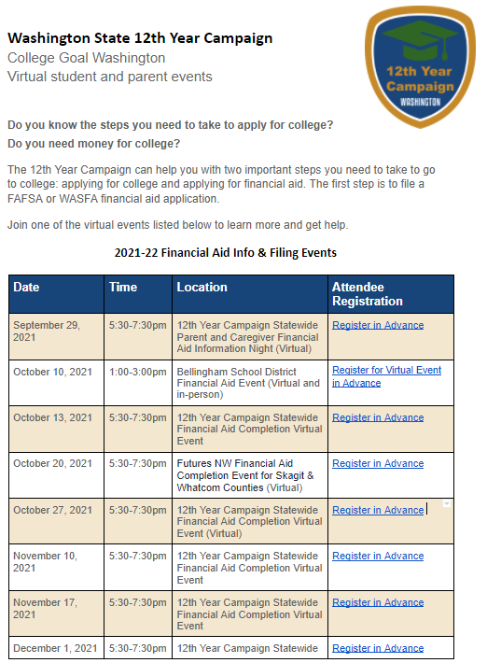
Virtual Events and Support
12th Year Campaign Sites Financial Aid Events
Majority of events are virtual and hosted on Zoom.
Hosted by colleges, community-based organizations, and high schools.
Informational events and completion events.
https://docs.google.com/document/d/1oELovlvqYmCD7NY0nDw7A_b1Bbeoj4-M7VNBDaQfxoI/edit?usp=sharing
Notes:
Beth – please split this into 2 slides so they are readable.

Slide 25
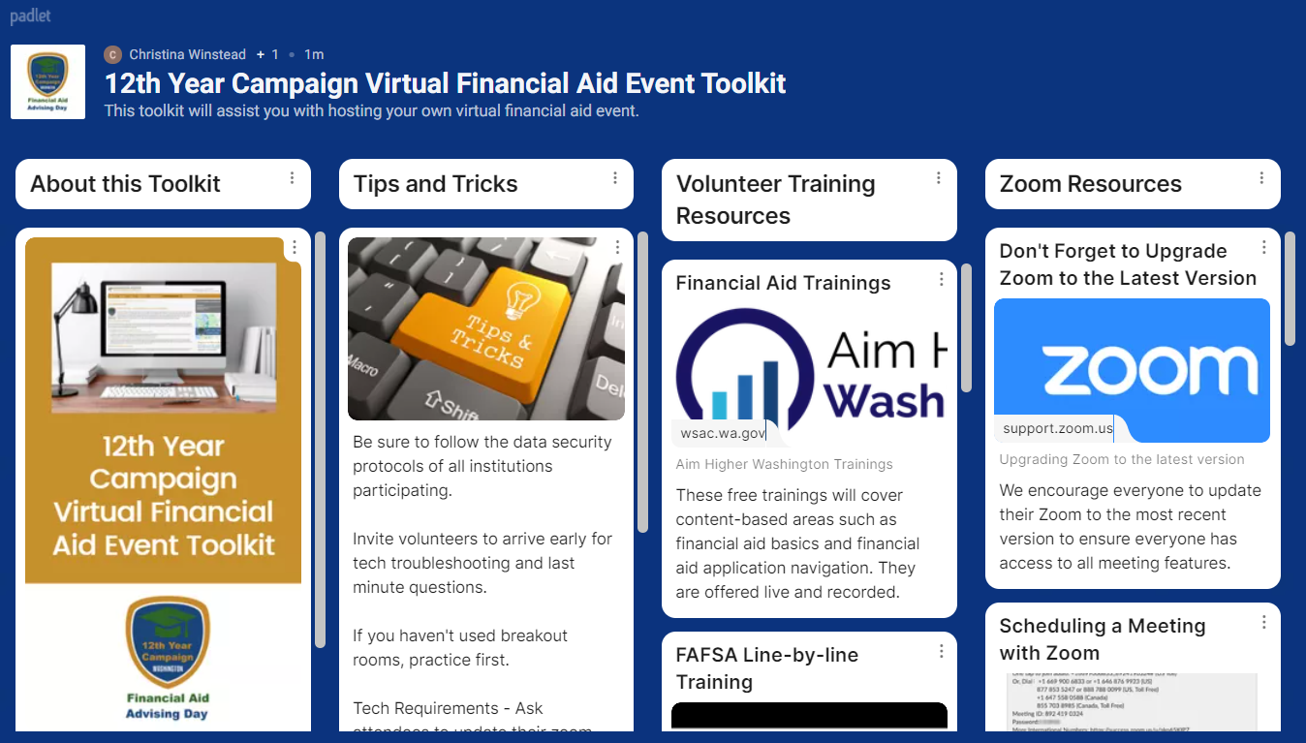
Virtual Events Toolkit
Notes:
Can we add a link so they know where to find this? Where do they get this information?

Slide 26
Financial Aid Advising Day
A financial aid advising day is an opportunity to provide every senior and their family with key resources and knowledge for completing the financial aid application process.
Per ESSB 6141, districts with a high school must provide both a financial aid advising day and notification of financial aid opportunities at the beginning of each school year to parents and guardians of any student entering the twelfth grade.
Notes:
Ask folks to share what they are doing if there is time (2 or 3?) Include asking how GU is involved. Discuss during RACI planning/team time.

Slide 27
Financial Aid Advising Day
Examples of District Information Requirements
Eligibility for WCG
Financial aid applications
Notification Requirements
School time, encouraged to support filing events with families outside of the school day
District process for opting out
Assistance
Many already doing similar work!
12th Year Campaign resources and statewide hosted financial aid completion events
New financial aid calculator
www.wsac.wa.gov/12th-year-campaign
Notes:
A financial aid advising day is an opportunity to provide every senior and their family with key resources and knowledge for completing the financial aid application process. Per ESSB 6141, districts with a high school must provide both a financial aid advising day and notification of financial aid opportunities at the beginning of each school year to parents and guardians of any student entering the twelfth grade. The notification must include information regarding:
The eligibility requirements of the Washington College Grant
Information on resources, such as the CSS profile and new financial aid calculator
Any community-based resources available to assist parents and guardians in understanding the requirements of and how to complete the free application for federal student aid (FAFSA) and the Washington application for state financial aid (WASFA)
The district’s process for opting out of the financial aid advising day
The full requirements of the financial aid advising day can be found in ESSB 6141
WSAC’s new 12th Year Campaign site is a one-stop shop for support for this initiative

Slide 28
OSPI/WSAC Wednesday Webinar Implementing Financial Aid Advising Day
Wednesday, 9/15, 9-10:30am
1.5 clock hours available
www.wsac.wa.gov/12th-year-campaign

Slide 29
Aim Higher Washington
Aim Higher is a coordinated effort to help more students in Washington apply for financial aid.
Aim Higher is focused on increasing equity in educational attainment for students of color and other marginalized groups.
The initiative identifies community-based partners statewide to help:
Create and expand college-going culture.
Increase the number of financial aid applications.
Notes:
What is Aim Higher - insiders

Slide 30
Aim Higher Washington Trainings
This partnership is a strategy central to our efforts to achieve racial equity in higher education. In alignment with each of our own organization's Equity, Diversity, and Inclusion commitments, the Aim Higher Training initiative is a step in the direction to providing all of Washington students with access to financial aid resources, information, and support.
Notes:
This partnership is a strategy central to our efforts to achieve racial equity in higher education. In alignment with each of our own organization's Equity, Diversity, and Inclusion commitments, the Aim Higher Training initiative is a step in the direction to providing all of Washington students with access to financial aid resources, information, and support.

Slide 31
Aim Higher Washington Trainings
Financial Aid Basics
Financial Aid Navigation
August 24th
11:00am-12:00pm
August 25th
10:00am-12:00pm
Clock Hours Available Register at https://wsac.wa.gov/aim-higher-training
Notes:
Financial aid basics
In this session, participants will learn the basics of financial aid. We will cover federal and state aid programs including grants, scholarships, work study and loans. We will also discuss when and where to apply for financial aid. Participants will leave with a better understanding of postsecondary funding. This session will prepare participants to help with basic financial aid questions. High school clock hours will be available.
Register - August 24 @ 11-12pm
Financial aid navigation
In this session, participants will learn about the financial aid process and how to help others navigate applying for financial aid. We will cover how to apply for postsecondary funding with the FAFSA and the WASFA. We will also discuss common challenges and errors as well as next steps. Participants will leave with a better understanding of how to help others with this important process. This sessions will prepare participants to assist students as they apply for financial aid and train others. High school clock hours will be available.
Register - August 25 @ 10-12pm

Slide 32
WASFA and Residency Updates
Before their first term at the college determining residency, students must:
Old – HB 1079
New– SB 5194
Earn a HS diploma, GED, or equivalent in WA
Earn a HS diploma, GED or equivalent from anywhere
Live in WA for 3 years immediately before earning diploma/equivalent and then continuously after
Maintain primary residence in WA for 1 year immediately before first term
Sign an affidavit saying they meet above requirements and will apply for US permanent residency when eligible.
32
Notes:
A new law makes it easier for Washingtonians, including undocumented people, to get resident tuition and state financial aid.
More undocumented people in Washington qualify for state financial aid than ever before.
Washington State is making state financial aid more accessible than ever, especially for undocumented Washingtonians.
Undocumented Washingtonians who have lived in Washington for a year may qualify for money for college or apprenticeships. Find out more at [website].
A new law replaces HB 1079. This law makes college more affordable for undocumented Washingtonians. Many people who didn’t qualify before are now eligible.
Both U.S. citizens and non-citizens can be Washington residents, including undocumented students. In most cases, a Washington resident is someone who lives in the state for one year immediately before starting college or an apprenticeship.

Slide 33
WASFA and Residency Updates
The WASFA has a new web address https://wsac.wa.gov/wasfa
The WASFA has been updated to reflect new residency requirements.
You can find the updated WASFA guide at https://wsac.wa.gov/sites/default/files/2021_WASFA_updated_instructions.pdf

Slide 34
College Bound Updates
Step One
Auto-enrollment for eligible public-school students.
Step Two
Meet income and residency requirements.
Fulfill the College Bound Pledge.
Foster Youth are auto-enrolled through HS graduation.
Eligible for FRPL in 7th, 8th, or newly eligible in 9th grade.
Be accepted to and attend an eligible college.
Notes:
Key takeaway: CBS is a two step process
Step 1: New with ESSB 5321, all FRPL eligible public school students in 7th, 8th, or newly eligible 9th graders will be auto-enrolled in CBS. Youth in state foster care are auto-enrolled throughout high school. This is GREAT! More students will have access to the CBS opportunity and those working with students can focus on college/career readiness rather than chasing down forms. CBS team is working on WAC updates.
Step 2:
- Fulfill the College Bound Pledge in high school (Grad from WA HS or homeschool program…2.0 GPA and no felonies)
additional note if asked about how do we know if they have a felony? WSAC has a review process that looks at public record searches and Washington State Patrol records to confirm a student’s eligibility.
- Meet income requirements; verified by the college using information from FAFSA or WASFA
- Be accepted to and attend an eligible college within one year of graduating high school (i.e. they have 5 years after graduating high school to use 4 years of funds – up to a bachelor’s degree- can’t use for grad school)

Slide 35
College Bound Updates
Combines with other state financial aid to cover the average cost of tuition (at public rates), some fees, and a small book allowance = commitment.
Can be used at over 65 two- and four-year public and private colleges and universities.
Notes:
Key takeway: You are probably familiar with College Bound and some of this but a good refresher. I’m going to give you some talking points to use with your students – so listen up!
CBS is still here and an important resource for students because:
Puts them in the pipeline for additional outreach and supports
Maximizes their potential state financial aid eligibility
Early state financial aid commitment to eligible students. CBS funds may come from different buckets of state financial aid (that were mentioned on the last slide), but those costs listed (tuition at public rates, small fees and book allowance will be covered)
Can be used for 4 year, 2 year, technical, vocational programs at over 65 schools in WA.
Since 2007, 300,000 students applied for the College Bound Scholarship.

Slide 36
Otterbot
Otterbot is a free texting service designed to help Washington high school seniors navigate financial aid for college and career education.
Students can access Otterbot via text message 24 hours a day, seven days a week by texting "Hi Otter" to 360-928-7281.
For more information on Otter visit wsac.wa.gov/otterbot

Slide 37
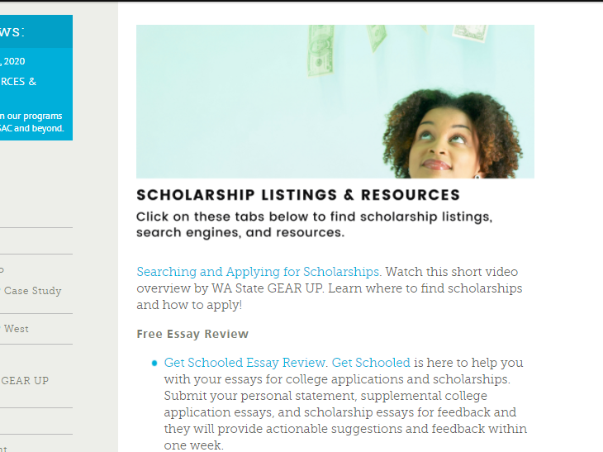
Scholarships
https://gearup.wa.gov/educators/scholarships
Notes:
Beth – this slide isn’t very readable. Can you fix it?

Slide 38
Financial Aid Trifolds
Notes:
Beth

Slide 39
NCCEP Study Lab
NCCEP (The national GEAR UP advocacy org) offers online professional development called The Study Lab. (Learn more: https://www.edpartnerships.org/study-lab#about-the-study-lab) Study Lab offers online courses that:
Were developed by experts.
Cover key topics for every role and level of experience.
Build on each other.
Are self-directed, short, and GEAR UP specific.
If you took the any courses last year, you will notice that they added NEW options to their catalog. View the selections: https://www.pathlms.com/nccep/courses
NCCEP also provides match. NCCEP members are eligible to receive cost-share (“GEAR UP match”) benefits when staff members or other designated individuals from member institutions enroll in Study Lab courses. (https://www.edpartnerships.org/study-lab-match)
If you would like to enroll or provide this training to your school staff/teammates, be sure to include this in your work plan and budget as a line item.
Notes:
Beth – are you prepared for this?

Slide 40
NCCEP Study Lab Registration
If you have NCCEP Study Lab courses in your Year 5 plan:
Select your classes when you are ready.
Notify Beth Kelly (bethk@wsac.wa.gov) of your course selection(s).
Beth Kelly will register you for the course(s).
You will be emailed the course information.
Complete the course. As a reminder, courses are about 4-6 hours each.
The match will be sent to WSAC and you will be credited the match.
Notes:
Beth – are you prepared for this?

Slide 41
GEAR UP West
October 17-19
Billings, Montana
Registration will open in August.
Hotel info not available yet.
Watch the Weekly Bulletin for information.
Only those who budgeted to attend in person are approved to attend.
Some sessions will be recorded for later viewing, but no hybrid option.
Notes:
Beth - We know that there are many unknowns, and each person has their own comfort level for traveling and attending conferences. These personal choices will be fully respected for GEAR UP West, and if you or anyone else changes their mind about attending GUW in person, please notify Kelly so she can update your plan.

Slide 42
Upcoming Events and Opportunities! Please check bulletin for additional details.
2021 Fall HS Counselor Virtual Workshops
NACAC Virtual College Fair Counselor Preview
Sunday, Aug. 29: Signature Fair
Sept. 10
Sept. 14
Sept. 16
Sunday, Sept. 12: Signature Fair
Sunday, Oct. 3 Signature Fair
Sunday, Oct. 24: Signature Fair
Sunday, Nov. 14: Signature Fair
Tuesday, Nov. 2: Arts & STEM Fair
PNACAC College Fairs
Tuesday, Sept. 28: Northeastern US Fair
Thursday, Oct. 14: Midwest US Fair
Monday, Sept. 24: Seattle PNACAC Fair
Notes:
Beth

Slide 43
National GEAR UP Week
September 20-24, 2021
Need help planning? Find our toolkit and resources at:
https://gearup.wa.gov/about/impact/national-gear-week
Notes:
Beth

Slide 44
RACI Guidance
What did you say you were going to do?
Use your final Work Plan and Budget for reference.
Only the activities in your Work Plan need to be included in the RACI
Who needs to be included in planning?
What are the details to be worked out?
Calendars, field trip approvals, transportation scheduled, etc.
Notes:
Marcie

Slide 45
Team Time Options Until 12:45
Join your team virtually in an assigned breakout room to complete your RACI or work in person.
Take a break as needed. Be prepared to share out with other priority or cohort school staff.
Notes:
Beth - You will be asked to select the room you want – AND if you are meeting in person, you don’t need to join a room.
If you are meeting in person- DON”T leave the meeting. Just mute, turn off your camera and go do your work.
If you want help during the team time, leave your room and join “WSAC ROOM” and someone will be there to help you.

Slide 46
Report Out/Share
Cohort 1 (Marcie) | Cohort 2 (Annie) | Priority 1 (Christina) | Priority 2 (Kelly)
Eastmont (483) | Aberdeen (266) | CHOICE & Cedar (150) | Inchelium (49)
Everett (408) | Blaine (189) | Davenport (145) | Klickitat (32)
Fort Vancouver (463) | East Valley (224) | Naselle (74) | Mansfield (31)
Hudson’s Bay (360) | Ilwaco (93) | North Beach (149) | Pateros (56)
Rogers (452) | Kettle Falls (69) | Wahkiakum (120) | Rosalia (20)
Shadle Park (324) | Skyview (81) | White Pass | Willapa Valley
Squalicum (330) | South Bend (59) |  | Wilson Creek
Thomas Jefferson (440) | West Valley (243)
Stay in the main room – Beth & Amy & Buffy
What are you most excited about doing this year?
What will be the greatest challenge for you?
What help do you still need?
Choose a recorder and send Marcie your notes – marcies@wsac.wa.gov.
Notes:
BETH + add to this slide

Slide 47
WAGU Program Updates

Slide 48
Portal Updates
September 15: Last day to create a new activity and/or enter participation for a Year 4.
Portal Year 5: 2021-22 - August 1, 2021 to August 31, 2022
Year 5 Orientations: Enter in Year 5
Remember – you won’t have students in the portal until after your school reports to CEDARS for the first time.

Slide 49
Year 4 – Final Compliance Review
31 Aug. 2021
Year 4 Ends August 31, 2021
15 Sep.
Year 4 Portal Entries Complete.
24 Sep.
Kelly will send final Compliance Review to Coordinators by this date.
30 Sep.
Return Compliance Review to Kelly with all issues resolved.

Slide 50
Contact Updates
Kelly sent out your school district contracts to Coordinators for review and corrections (yesterday).
Please send additions/deletions/corrections to Kelly by Friday, August 27.

Slide 51
Fiscal Updates – Please share with Fiscal Leads
Year 4 is 08/31-21or before.
All Y4 items must be INVOICED and RECEIVED by August 31st.
If you are purchasing items for Y5 with Y4 funds. This needs prior approval from Marcie and must be in your Y4 Work Plan and Budget.
Not in your plan or budget? It won’t be reimbursed.
October 29th – final due date for Year 4 A19s for reimbursement. No exceptions.
Year 5 is 9/1/2021 through 8/31/2022.
Any invoice dated and/or received on or after Sept. 1 is Y5 and must be in your plan.
First Year 5 A19 is due the week of October 25 (for September expenditures).
September payroll is Year 5. Always.
Notes:
Buffy – anything to add?

Slide 52
New Resources/Revamped Site
Student Alumni Webpage Template
Educator College & Career Exploration Resources
Virtual Career and Tech Prep Series
WAGU Orientation Templates

Slide 53
Professional Development Plan
Planning to host In-Person events if safe. The dates and locations can be found on our GEAR UP Calendar.
New! Monthly brief webinars that align with your workplan. Hear from WSAC staff about resources and tools to help you in these areas. Connect with your peers. Get technical assistance.
Notes:
The DRAFT calendar was sent to you last week. Are there any concerns with any of the dates as listed? Speak up now. We will finalize the calendar this week, and it will be sent out to you, and posted on our website.
Webinars are required for GEAR UP directors, coordinators, and graduation specialists (or similar job titles). Optional for everyone else. Please make sure you put them on your calendar now.

Slide 54
Match
Per your contract, the current match rate required is 50%.
We have requested a match waiver from the Department of Education.
We have not received approval but expect that we will.
Once received, we will likely decrease the match required for this year.
Do not over match. Focus on your students and families. We will have enough.

Slide 55
Closing Remarks
Any questions? Comments?
Type in the chat something you are looking forward to!

Slide 56
Closing: Evaluation: https://survey.alchemer.com/s3/6485423/GEAR-UP-Year-5-Kickoff-Workshop

