Slide 1
Washington College Grant (WCG)
Washington State has made a groundbreaking commitment to financial aid for low- and middle-income people of all ages with the new Washington College Grant (WCG).

Slide 2
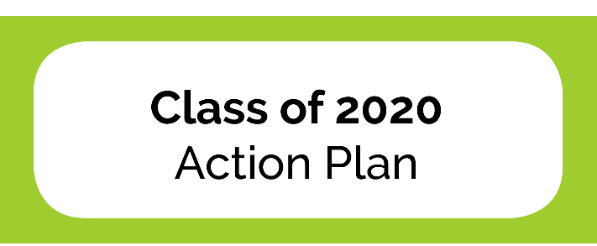
Opportunity Pathways (wsac.wa.gov/pathways)
It’s never too early to plan ahead. It’s never too late to change your future.
The new Washington College Grant gives more money to more students for more kinds of education after high school.
Any education after high school—college, apprenticeship, or other training—expands career options and increases earning potential.
There are affordable college and career training opportunities for everyone. The first, best step is to apply for financial aid.
Notes:
BT Talking point – Using Opportunity Pathways terminology more broadly.

Slide 3
What About College Bound?
CBS is a college access and support program.
Promotes college-going culture by starting the conversation in middle school.
Provides six years of support and motivation.
Counselors and advocates receive resources and help engage families.
CBS has additional financial benefits.
Provides additional funding for a small book allowance.
Awards are not prorated based on income level for eligible students.

Slide 4
Washington College Grant
Replaces the State Need Grant. Major changes begin in fall 2020.
2019-20
Additional funding to serve about 6,000 more students.
2020-21
Guaranteed funding for eligible students.
Maximum award amounts increased to cover full tuition and fees at public rates.
Expanded eligibility to 100% Median Family Income.
Registered apprenticeships added.
Notes:
Two year phase-in (insider audience) – need to create w/ higher-level 2019-20 language

Slide 5
Washington College Grant
Replaces the State Need Grant. Major changes begin in fall 2020.
2019-20
It’s not too late to apply for aid for 2019-20.
2020-21
Guaranteed funding for eligible students.
Ask your school’s financial aid office if you can receive WCG.
Expanded eligibility to 100% Median Family Income.
Registered apprenticeships added.
Notes:
Higher-level, non-insider audience (adjusted 2019-20 language)

Slide 6
Washington College Grant: Award examples
Example | Income level (% of WA Median Family Income) | Income at MFI cap for a family of 4 (2019-20 levels) | Current through 2019-20 |  | Starting in 2020-21
 |  |  | Award proration | Award amount | Award proration | Award amount
Ex.1 | 51 – 55 | $50,500 | 70% of max award | $2,875 | 100% | $4,108
Ex.2 | 76 – 100 | $92,000 | Not eligible | Not eligible | 10% | $410
Note. Examples for illustration purposes only. Based on full-time CTC student and 2019-20 award amounts.

Slide 7
Washington College Grant: Income eligibility
Income level (% of WA Median Family Income) | Income at MFI cap for a family of 4 (2019-20 levels) | Award proration (% of max award)
 |  | Current through 2019-20 | Starting in 2020-21
0 – 50 | $46,000 | 100% | 100%
51 – 55 | $50,500 | 70% | 100%
56 – 60 | $55,000 | 65% | 70%
61 – 65 | $59,500 | 60% | 60%
66 – 70 | $64,000 | 50% | 50%
71 – 75 | $69,000 | Not eligible | 24.5%
76 – 100 | $97,000 | Not eligible | 10%
Source: WSAC Published MFI Chart for 2019-20 WCG

Slide 8
Washington College Grant: Increased funding
Funding of other need-based programs
Program | 2019-20 | 2020-21
College Bound | $19.5 M | $17 M
State Work Study | $7.8 M | $7.8 M
Passport to College | $2.2 M | $2.2 M
Passport to Careers | $0.5 M | $0.5 M

Slide 9
Washington College Grant: Award amounts
Maximum award amounts for public institutions increase to cover full tuition and fees
Can be used to cover other educational costs, as determined by financial aid administrator
Award amount is prorated based on income eligibility (MFI level) and enrollment level
2019-20 Maximum Award Amount
for full-time students
attending 3 quarters or 2 semesters
$4,108 at CTCs
$6,587 for Applied Bachelor’s at CTCs
Notes:
CTC example, grab other sectors (ICW presentation)

Slide 10
Washington College Grant: Award examples
Example | Income level (% of WA Median Family Income) | Income at MFI cap for a family of 4 (2019-20 levels) | Current through 2019-20 |  | Starting in 2020-21
 |  |  | Award proration | Award amount | Award proration | Award amount
Ex.1 | 51 – 55 | $50,500 | 70% of max award | $2,875 | 100% | $4,108
Ex.2 | 76 – 100 | $92,000 | Not eligible | Not eligible | 10% | $410
Note. Examples for illustration purposes only. Based on full-time CTC student and 2019-20 award amounts.

Slide 11
Reacher Higher Washington
The combination of the Washington College Grant
and the investment to increase financial aid applications
provides a unique opportunity to engage statewide.
WSAC’s affordability initiative focused on increasing financial aid applications (FAFSA/WASFA) for the High School Graduating Class of 2020.
12th Year Campaign
Outreach to students, parents, and local educators
Partnerships with education and government leaders
Digital Tools, including texting to CBS seniors

Slide 12
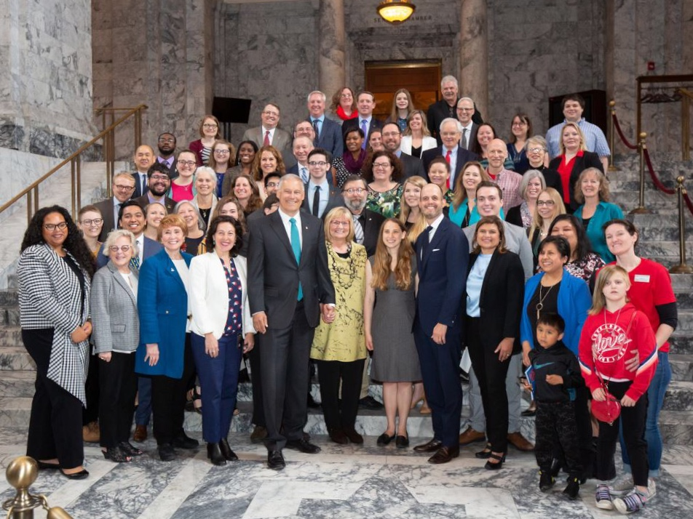
Workforce Education Investment Act – HB 2158
Historic investment creates dedicated revenue source for higher education.
Three-tiered increase to state’s business-and-occupation tax paid by professions that depend on higher education
Oversight board
Revenue for 2019-20 estimated at $373.8 million.
Used on higher education operations, compensation, programs, and student aid.
Notes:
Op-Ed in Seattle Times outlined vision by:
Brad Smith – Microsoft President,
Ana Mari Cauce – UW President
Wayne Martin – SBCTC vice chairman
Three tiered surcharge on the total amount of taxes payable by the business on activities taxed under the B&) rate for services:
20% increase (from 1.5% to 1.8%) on 40 categories of technical services (telecom, engineering, medical, finance)
33% increase (to 2.0%) on tech firms with >$25B in annual revenue
67% increase (to 2.5%) for advanced computing businesses with worldwide annual revenue of >$100B (Microsoft & Amazon)
Prime Sponsor: Rep. Drew Hansen, D-Bainbridge Island
Revenue estimated at about 1B over the next four years

