Slide 1
Student and Family Orientation
Welcome
Notes:
ID=d924773e-9a16-4d6d-9803-8cb819e99682 Recipe=text_billboard Type=TextOnly Variant=0 FamilyID=AccentBoxWalbaum_Zero

Slide 2
Agenda
What is GEAR UP?
How Can GEAR UP Help You and Your Student?
Where Can You Find Resources?
School Specific Content

Slide 3
Our Team

Slide 4
What is GEAR UP?
Our school receives a GEAR UP grant from Washington Student Achievement Council to provide services and resources to help students prepare of continuing their education beyond high school.
We can help students with tutoring, mentoring, college visits, academic preparation, counseling and advising.

Slide 5
GEAR UP’s vision is that all students are academically, socially, and financially prepared to enter and complete the postsecondary program or institution of their choice.
Our Vision
Notes:
Our goal is that all students are prepared to pursue a career that has labor market value. That means that they have researched career options, know how their interests align with career choices, and know the steps they need to take after high school to be ready for their career. That might be an apprenticeship, on-the-job-training, or college.

Slide 6
Washington State GEAR UP
26 school districts.
Over 6,000 students and their families are served annually, starting in the 7th grade through the end of their first year after high school.
GEAR UP staff build personalized relationships with students and families to build and support student aspirations – and their goals for continuing their education beyond high school.
Provide the academic support needed to ensure students graduate on time.

Slide 7
What Do We Mean When We Say Postsecondary Education and Training?
We mean any type of education or training after high school.
There are many options for students after high school including apprenticeships, military, on-the-job training programs, community college certificates, 2-year degrees, & 4-year degrees.
The term postsecondary education and training includes all these things.
Notes:
We use the terms “postsecondary education” and “postsecondary training”.
Many people think college is just a 4 year program, but there are many options. We want students to find the right fit. Explain that this is called “postsecondary education” because it is after (or “post”) high school (secondary education). Postsecondary education is often called “college”. College can be 4-year university, 2-year college or technical college, military training, certificate programs, or apprenticeships.
GEAR UP wants to make sure students are prepared for whatever option THEY choose to pursue.

Slide 8
GEAR UP Services
Academic enrichment, support and tutoring
College admissions test preparation and funding
Career exploration, research, guest speakers and job site visits
College research, virtual and in-person tours, guest speakers
Counseling, advising and mentoring
Family events and counseling and advising
Financial aid information and support, including FAFSA/WASFA application completion, scholarship applications, and award letter interpretation
College application completion support
Life skills

Slide 9
GEAR UP Calendar
Notes:
Schools can highlight their events/dates here

Slide 10
Student Activities
Notes:
Include your offerings for example:
Tutoring and office hours
Virtual and in-person college tours and job shadows
Career presentations
Life skills workshops, guest speakers, and more!
Financial aid education
Family workshops
Summer camp opportunities

Slide 11
Family Events & Resources
Notes:
Leave blank so schools can fill in their own

Slide 12
https://gearup.wa.gov/students-families
Prepare for College
Explore Pathways
Visit a Campus
Prepare for Exams
Apply to College
Pay for College
Search for Scholarships
Build a Support System/Transition After HS
Notes:
Students and families can find information and a number of resources here including on the topics above.

Slide 13
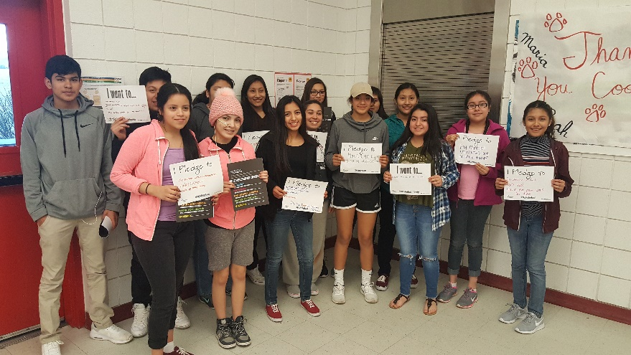
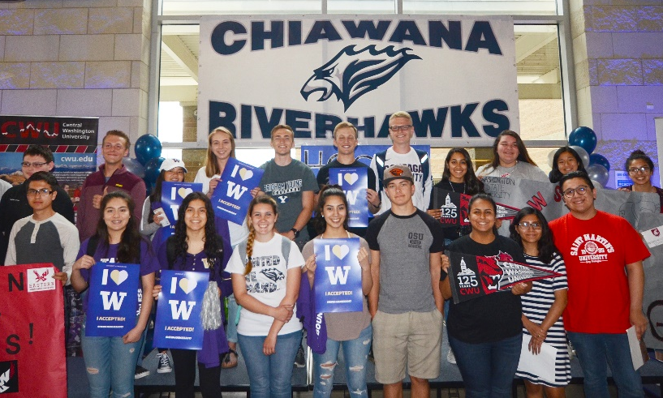
Get Plugged In
Fall
12th year Campaign!
Winter
College Bound Scholarship Repledge
Spring
College Signing Celebrations
Notes:
If your school is conducting these activities, you may wish to talk about if GEAR UP is involved.
FAFSA/WASFA: We are working in collaborations with WSAC and individual schools to provide FAFSA and WASFA completion efforts specifically for College Bound students. Please see a regional officer if you have any questions on how to implement targeted strategies for students.
Repledge: The College Bound Scholarship Pledge can be used as a lever to improve student success outcomes for low-income students from 7-12th grade. 9th grade is a critical place to start! We know that 9th grade students earn the lowest GPA, have the most amount of missed classes, and have the highest misbehavior rates. The College Bound Repledge campaign is an opportunity to re-engage College Bound Scholarship ninth grade students in high school and remind them of their commitment.
College Signing Celebrations: College Signing Day celebrates students who have achieved the life-changing milestone of committing to postsecondary options. College Signing Day events motivate students to take charge of their future by completing their education beyond high school. WCAN is working with school districts across the state to empower schools to host their own College Signing Celebrations to highlight students enlisting or committing to obtaining a postsecondary degree or certification. We will be asking schools to celebrate with us throughout the month of May and June or when is best for your school and district.

Slide 14
Thank you
Presenter name
Email address
Website
Notes:
Leave some additional blank slides so they can insert their own content.

